Slide 1

Connectionless Streaming of Multimedia Content
Akademia Górniczo-Hutnicza im. Stanisława Staszica w Krakowie
AGH University of Science and Technology
Mikołaj Leszczuk

Slide 2

Introduction – What Is Media Streaming in Practice?
“Multimedia that is constantly received by and presented to an end-user while being delivered by a provider”
Providing multimedia information (usually: on request)
Transmission of compressed multimedia data over the Internet
Notes:
Streaming media is multimedia that is constantly received by and presented to an end user while being delivered by a provider over the Internet. The verb to stream refers to the process of delivering or obtaining media in a continuous manner from a particular source. Streaming refers to the delivery method of the medium, rather than the medium itself. Distinguishing delivery method from the media distributed applies specifically to telecommunications networks, as most of the traditional media delivery systems are either inherently streaming (e.g. radio, television) or inherently non-streaming (e.g. books, videotape, audio CDs). There are challenges with streaming content on the Internet. For example, users whose Internet connection lacks sufficient bandwidth may experience stops, lags, or slow buffering of the content. And users lacking compatible hardware or software systems may be unable to stream certain content. With the use of buffering content just a few seconds in advance, the quality can get much better.
Video coding and distribution basic tutorial

Slide 3

Streaming Technology
Notes:
PL: https://youtu.be/qBJZP4NQwf0

Slide 4
Two Types of Access to Streaming Media
Live (Broadcasting)
On Request (on Demand)
Video captured on server
All users watching same video
Example: live concert streaming
Video stored on server
Each user choose video to watch
Example: VOD movie streaming

Slide 5
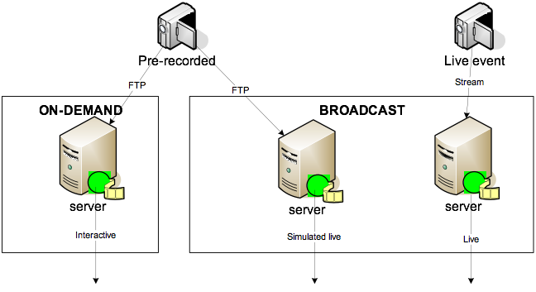
Serving: Live Broadcasting & On-Demand

Slide 6
What Do We Actually Expect from „Video Service”?
What happens when you click?
Download
Playback
How advanced control?
Only ▶️ (“Play”)
Full media controls:
▶️ (“Play”)
⏸ (“Pause”)
⏹ (“Stop”)
⏪ (“Rewind”)
⏩ (“Fast forward”)
And if we have excess bandwidth?
Download „in advance”
Reallocation of resources to other users
And if network, will not handle this?
Wait until buffered
We accept breaks in transmission

Slide 7
Communication?
Connectionless
Less overhead
Precise control of resources
Connection-Oriented
More overhead
Rough control of resources
Dedicated server
HTTP server
Limited network support
Global network support

Slide 8
Introducing Real-Time Streaming Protocol (RTP)
Transport layer protocol for real-time streaming media…
Not a standalone protocol
Requiring another transport protocol to combine with:
Theoretically: any transport protocol
Practically: used only with User Datagram Protocol (UDP)
Inheriting UDP features, including support for both Unicast and Multicast transmissions
UDP+RTP – good multimedia transport protocol
RTP header located between UDP header and UDP payload (but not another network layer!)
Notes:
The Real-time Transport Protocol (RTP) is a network protocol for delivering audio and video over IP networks. RTP is used in communication and entertainment systems that involve streaming media, such as telephony, video teleconference applications including WebRTC, television services and web-based push-to-talk features.
RTP typically runs over User Datagram Protocol (UDP). RTP is used in conjunction with the RTP Control Protocol (RTCP). While RTP carries the media streams (e.g., audio and video), RTCP is used to monitor transmission statistics and quality of service (QoS) and aids synchronization of multiple streams. RTP is one of the technical foundations of Voice over IP and in this context is often used in conjunction with a signaling protocol such as the Session Initiation Protocol (SIP) which establishes connections across the network.
RTP allows data transfer to multiple destinations through IP multicast.

Slide 9
RTP and Quality of Service (QoS)
No guarantee for QoS in RTP
QoS guarantees through cooperation with other protocols, such as:
Real-Time Streaming Protocol (RTSP)
Session Initiation Protocol (SIP)
H.323
Resource Reservation Protocol (RSVP)
Their task: to establish a connection before data can be transmitted using the RTP
Notes:
RTP does not guarantee the Quality of Service (QoS).
To guarantee QoS, RTP is used together with other protocols such as RTSP, SIP, H.323, RSVP, which are used to establish a connection before data can be transferred via RTP.

Slide 10
RTP Limited “Real-Time”
Does not reserve resources
Does not guarantee QoS for real-time services, including:
Packet delivery (at all)
Scheduled packet delivery (even in lower layers do guarantee)
Ordered packet delivery
But extends UDP with information on:
Type of transmitted data
Timestamp
Serial number (of packet)
Notes:
RTP has a limited "real time".
There is no guarantee of network resources in RTP.
There is also no guarantee of service quality for real-time services, including:
- package delivery (at all),
- timely delivery of the package (even when guaranteed by lower layers), and
- delivering packages in the correct order.

Slide 11
RTP Sequential Number
Sending packet order possible to reconstruct at receiver
Possible to correctly localize packet in stream (e.g., without decompressing video frames)
Notes:
Thanks to RTP sequential numbering, it is possible to reconstruct the order in which packets are sent at the receiver. It is also possible to correctly locate the packet in the stream (e.g. without decompressing the video frames).

Slide 12
Applications of RTP
Multipoint audio/video-conferencing (primary application)
Voice over IP (VoIP)
Video on Demand (VoD)
Other applications of audio/video
Distributed simulations
Games
Monitoring
Other applications having access to real-time data
Notes:
What are the application areas of RTP?
RTP was initially created for the purpose of multi-party video conferencing.
Currently, it supports many real-time network applications such as:
- video applications,
- audio applications,
- data access applications,
- applications for distributed, interactive simulations,
- games, and
- monitoring applications.

Slide 13
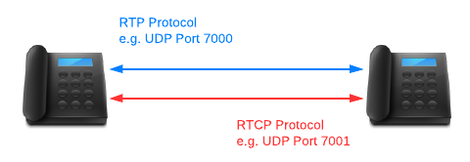
RTP Control Protocol (RTCP)
Not to be confused with Real Time Streaming Protocol (RTSP)
RTP transport controlled by RTCP
Main additional functionality by RTCP – QoS monitoring for volumes of data transports
RTP and RTCP working simultaneously
Notes:
The RTP Control Protocol (RTCP) is a sister protocol of the Real-time Transport Protocol (RTP). Its basic functionality and packet structure is defined in RFC 3550. RTCP provides out-of-band statistics and control information for an RTP session. It partners with RTP in the delivery and packaging of multimedia data, but does not transport any media data itself.
The primary function of RTCP is to provide feedback on the quality of service (QoS) in media distribution by periodically sending statistics information such as transmitted octet and packet counts, packet loss, packet delay variation, and round-trip delay time to participants in a streaming multimedia session. An application may use this information to control quality of service parameters, perhaps by limiting flow, or using a different codec.

Slide 14
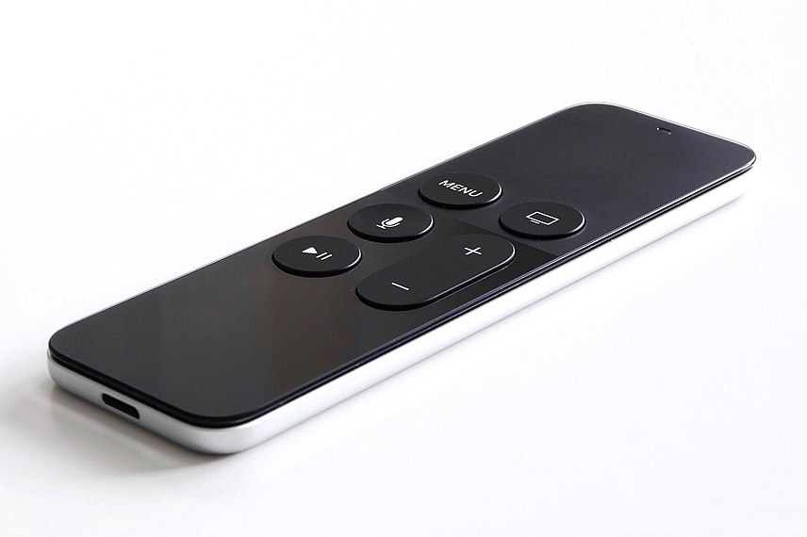
Real Time Streaming Protocol (RTSP)
Application layer protocol to control streaming media server
„Network remote control” for multimedia servers and more
Negotiating:
Communication (Unicast, Multicast…)
Transport protocols (UDP, RTP, HTTP…)
Codecs…
Syntax similar to HTTP, but supports states
To zdjęcie, autor: Nieznany autor, licencja: CC BY-SA
Notes:
The Real Time Streaming Protocol (RTSP) is a network control protocol designed for use in entertainment and communications systems to control streaming media servers. The protocol is used for establishing and controlling media sessions between endpoints. Clients of media servers issue commands such as play, record and pause, to facilitate real-time control of the media streaming from the server to a client (Video On Demand) or from a client to the server (Voice Recording).

Slide 15
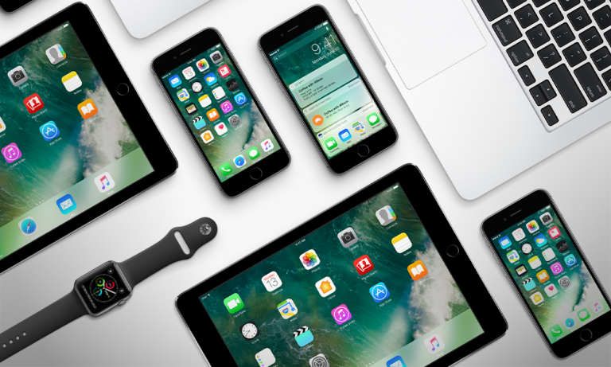
Transporting Content to Various User Devices
TV sets
Set-top boxes
Video game consoles
Computers
Tablet computers
Smartphones
Smartwatches
To zdjęcie, autor: Nieznany autor, licencja: CC BY-SA-NC

Slide 16
Transcoder
Various technical limitations for:
Screen size and type
Processor
Memory for buffering
Communications
Power source
No universal digital video signal directly available for all kinds of devices
Solution: transcoder
Notes:
Let's talk about transporting content to the user.
As we have already told ourselves, we have different devices.
So you need to access digital video libraries using multiple internet devices.
They have different technical possibilities for:
- display,
- processing,
- storage, and
- communication.

Slide 17
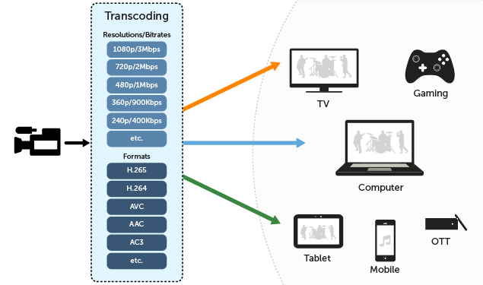
Transcoding for Live Video Streaming
Source: Wowza Media Systems
Notes:
Transcoding is the direct digital-to-digital conversion of one encoding to another, such as for movie data files or audio files (e.g., MP3, WAV). This is usually done in cases where a target device (or workflow) does not support the format or has limited storage capacity that mandates a reduced file size, or to convert incompatible or obsolete data to a better-supported or modern format.
Transcoding is commonly a lossy process, introducing generation loss; however, transcoding can be lossless if the output is either lossless compressed or uncompressed. The process of transcoding into a lossy format introduces varying degrees of generation loss, while the transcoding from lossy to lossless or uncompressed is technically a lossless conversion because no information is lost; however, the process is irreversible and is more correctly known as destructive.

Slide 18
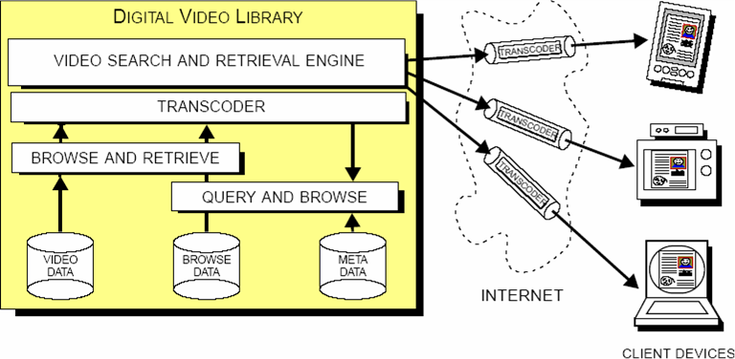
Transcoding Architecture
Based on: J. R. Smith, “Digital video libraries and the Internet”
Notes:
Let's talk about the transcoding architecture for transporting content to the user. The transcoder can interface directly with the search and retrieval engine to adapt the video data and browse data to the client devices, as shown in figure. Potentially, intelligence can be added to a transcoder in the digital video library in several ways. For example, given the rank ordered results list from a query, the transcoder can conserve bandwidth by delivering the browse data for the items with higher rank at a higher fidelity (and higher data rate) than the browse data for items with a lower rank.

